Slide 1

MoodMatrix : AI-Powered Study Companion

Slide 2

MoodMatrix : AI-Powered Study Companion
Problem Statement :
In large classrooms (schools, colleges, coaching's, etc.), teacher often lack real-time visibility into students’ engagement, their attention level, and emotional states, which makes it difficult to adapt teaching methods dynamically. Traditional observation methods are subjective, time-consuming, and impractical for monitoring every student simultaneously, especially in classes with 60+ students.

Slide 3

MoodMatrix : AI-Powered Study Companion
There is a need for a scalable system that can:
Detect and track students’ expressions, posture, and attention in real time.
Aggregate signals into group metrics (e.g., % attentive, emotions, heatmaps).
Provide actionable, real-time feedback to instructors.
Preserve privacy with edge processing and anonymized data sharing.
USP: Adaptive timetable that aligns study hours with peak focus and emotional readiness.
Adjusts PPTs of teachers and study material as per the attention level of the students during lectures.

Slide 4




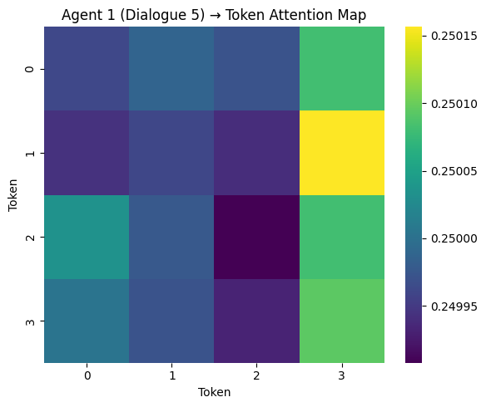
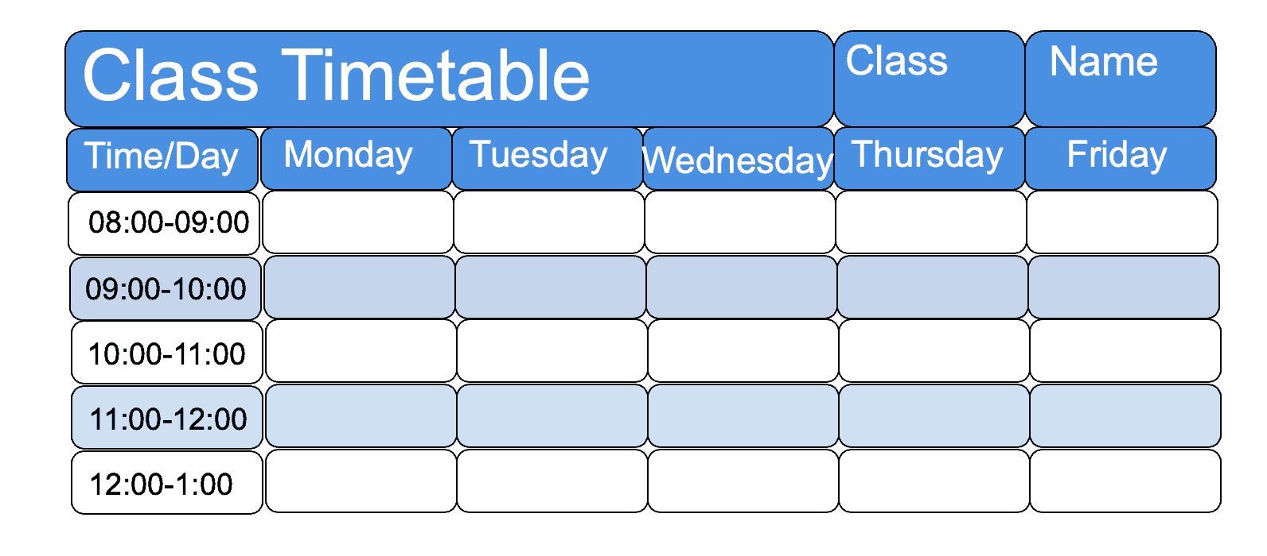
Outcomes & Workflow
Real-time monitoring of student attention, their posture and emotions.
Group-level attention metrics and visual heatmaps for class engagement to create a timetable to get maximum output
Real time feedback to help teachers adapt their teaching style dynamically.
Privacy-preserving system with secure data handling.
Scalable edge-based solution for classrooms of varying sizes.
Academic Success
Various Subjects
Cognitive Load–Aware Timetable
Attention Heatmaps

Slide 5

Features
Tools Used:
Hardware:
Jetson nano
Speaker and mic
2 Cameras
Emotion Aware Study Companion
AI Tutor for discussion
Distraction Monitor
Motivational Friend
Emotional Stats Analyzer and Time-Table Creation
Dynamic Time-Table – Priority wise task execution
Software:
MediaPipe or MoveNet for posture recognition
Distraction detection using facial and audio analysis
Python (FastAPI) for backend, etc.

Slide 6
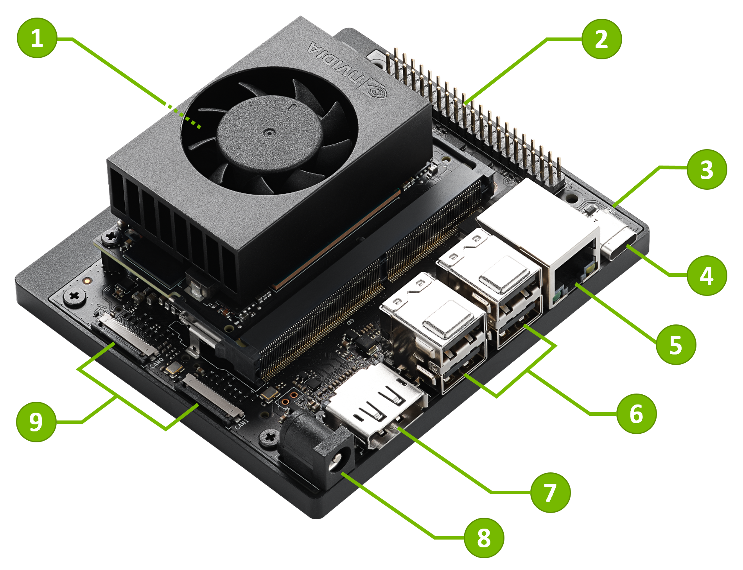
Jetson Nano
microSD card slot for main storage
40-pin expansion header
Power indicator LED
USB-C port for data only
Gigabit Ethernet port
USB 3.1 Type A ports (x4)
DisplayPort connector
DC Barrel jack for 19V power input
MIPI CSI camera connectors

Slide 7



How Hardware Makes It Profitable ?
Integrating IoT hardware not only enhances the user experience but also unlocks powerful, diversified revenue streams and establishes a formidable competitive advantage in the burgeoning wellness market.
Multiple Revenue Streams
Competitive Advantage
Broad Market Impact
Device Sales: One-time purchase of the premium IoT mood assistant.
Always-On Monitoring: Continuous, passive data collection without requiring active app engagement.
Students: Combats procrastination and improves focus with automated, mood-responsive scheduling.
Subscriptions: Tiered plans for advanced analytics, cloud data storage, and exclusive AI-driven wellness upgrades.
Physical Feedback: Intuitive responses via LEDs, subtle sounds, voice prompts, and direct smart home control.
Employees: Reduces burnout by prompting mood-based breaks and fostering a healthier work-life balance.

Slide 8
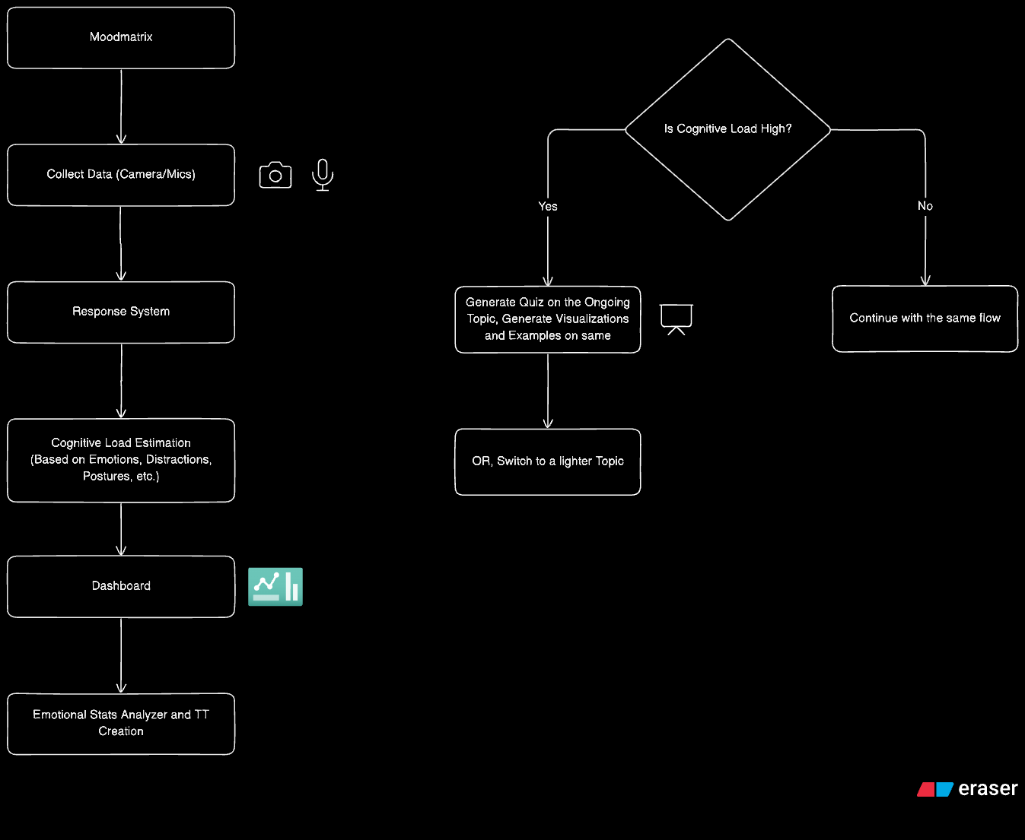
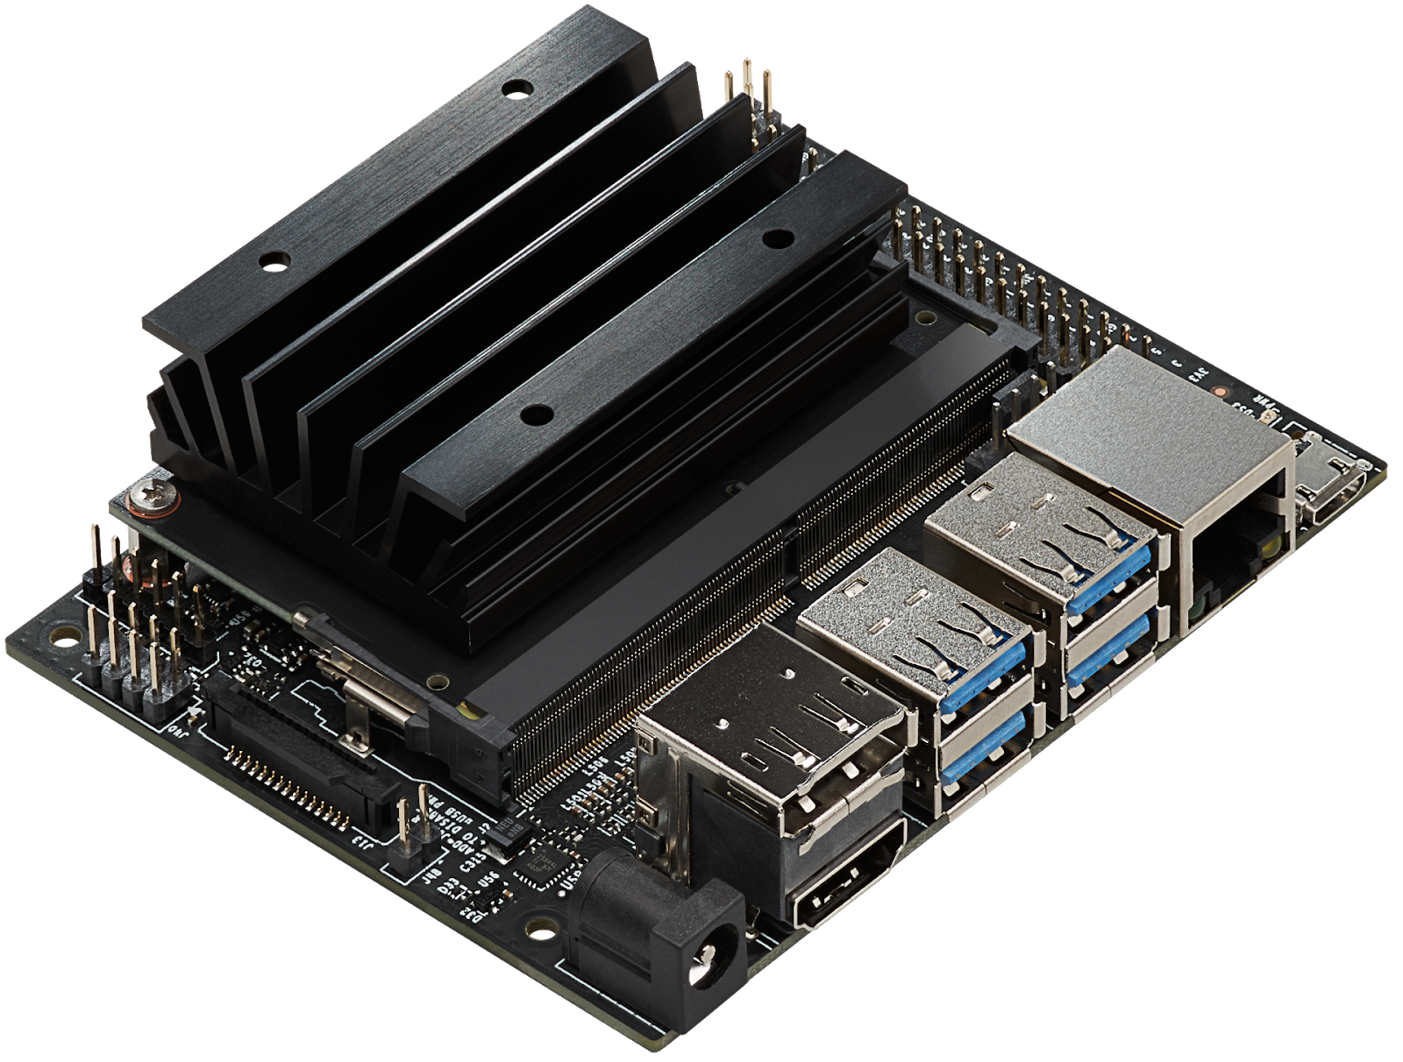
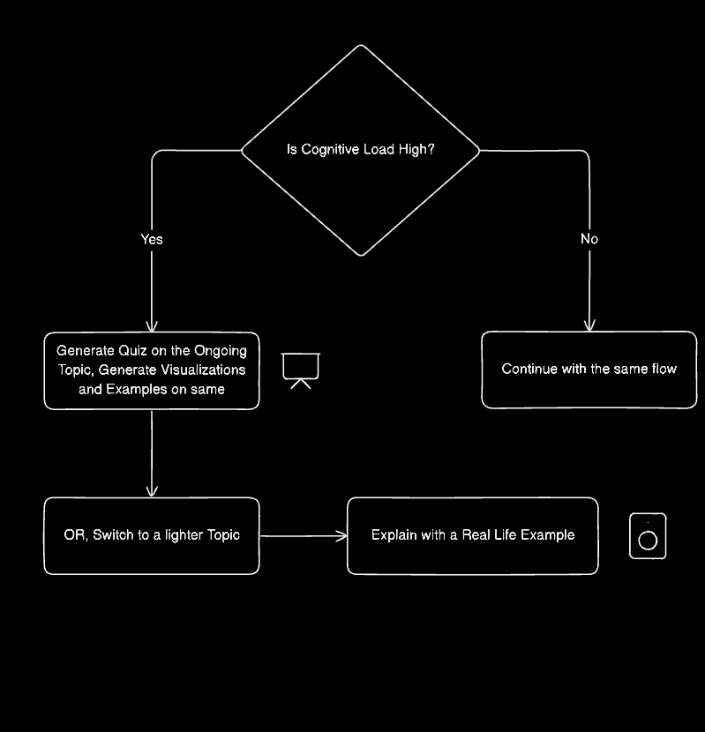
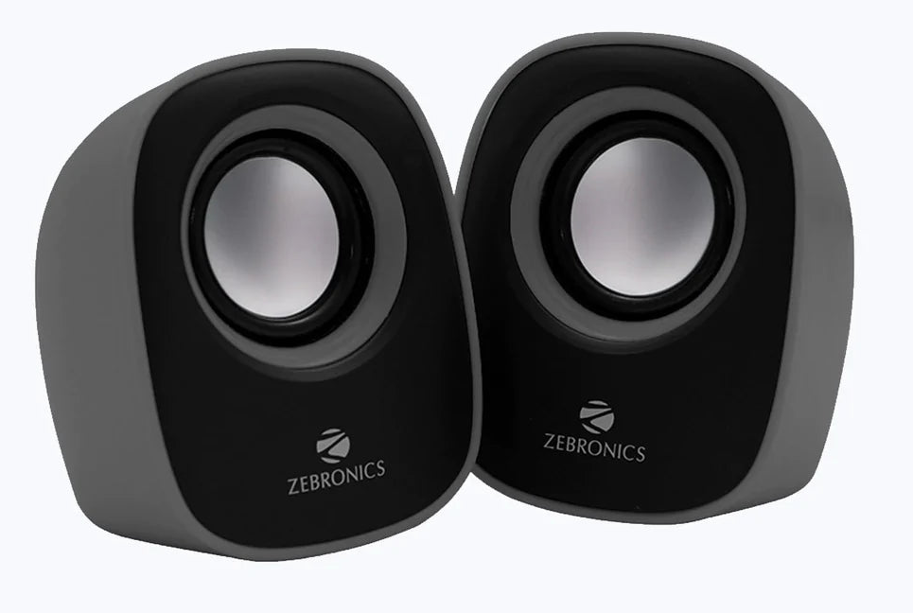
Block Diagram
Audio Output

Slide 9
SR. NO | Title of Research Paper | Authors | Name of Journal/ Conference | Date of Pub. | Summary
1 | Improve Learner-based Recommender System with Learner’s Mood in Online Learning Platform | Qing Tang Marie-Hélène Abel | IEEE | 2021 | Recommender systems address issue of scattered information by suggesting personalized content. The proposed system enhances recommendations by considering not only learners’ attributes (e.g., style, ability, knowledge) but also their mood, adapting strategies dynamically to improve accuracy, relevance, and interpretability.
2 | The Impact of Positive Mood on Learning | Dr. Tanis Bryan, Ph.D., Sarup Mathur, Ph.D., and Karen Sullivan | Sage Journal | 1996 | This study examined how a brief positive mood induction affects early reading acquisition and its durability over two weeks. Results showed that while both groups in the positive condition outperformed the neutral group (not statistically significant overall), students with learning disabilities showed significant long-term gains when learning in a positive mood.

Slide 10
SR. NO | Title of Research Paper | Authors | Name of Journal/ Conference | Date of Pub. | Summary
3 | A Reconsideration of Cognitive Load Theory | --- | Springer Nature | 2007 | The proposed system reexamines Cognitive Load Theory (CLT) in the context of digital and online learning. While CLT traditionally emphasizes reducing extraneous cognitive load, new evidence shows that design features such as interactivity, immersion, realism, disfluency, and emotional design can increase cognitive load but still enhance motivation and learning
4 | Mood based E-learning using EEG | Namita. R. Tambe; Ajitkumar Khachane | IEEE | 2016 | The paper discusses a smart E-learning system that utilizes EEG sensors to detect users' emotions and attention levels. By analyzing brainwave signals, it predicts appropriate video content to enhance the learning experience, addressing limitations of traditional E-learning systems.

